Slide 1

ReACT Agent for Personal Financial Management
Jingxi Qiu, Zeyu Han, Yian Hu

Slide 2
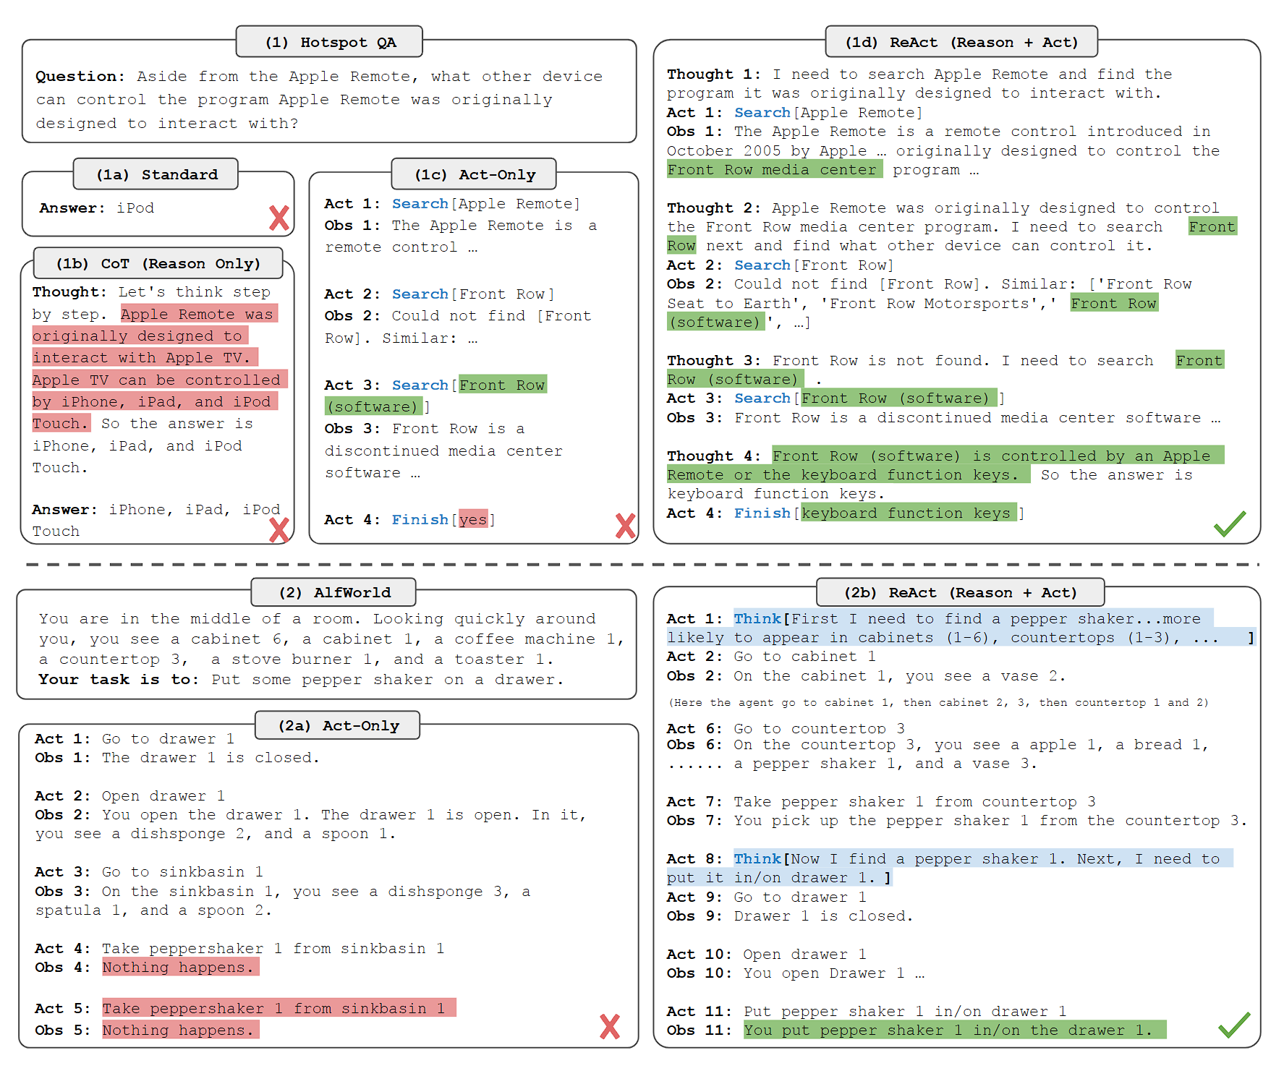
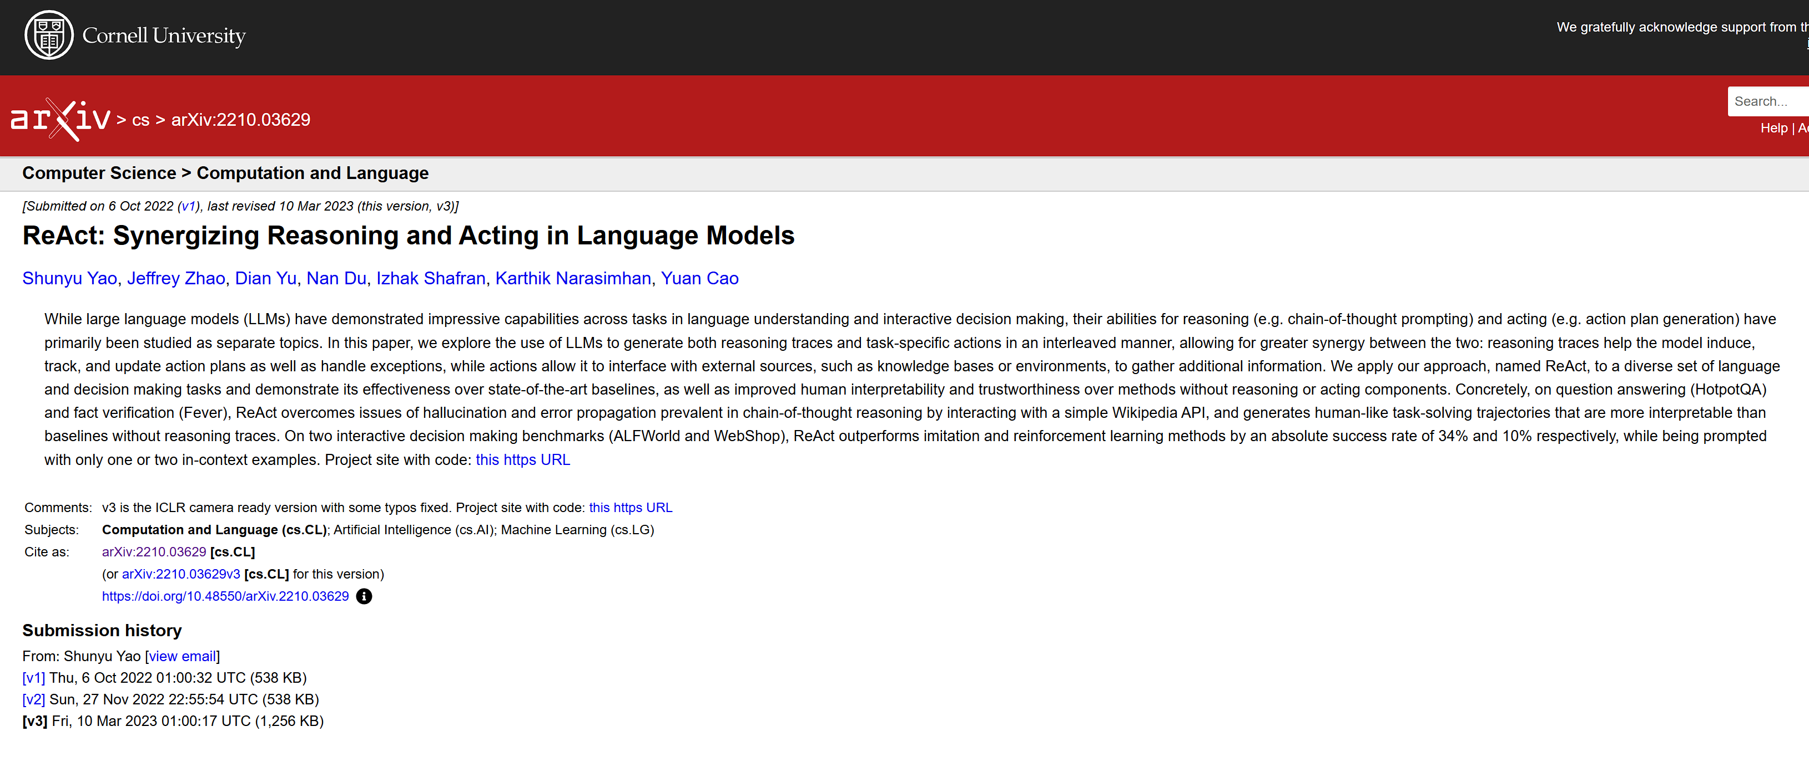

Slide 3
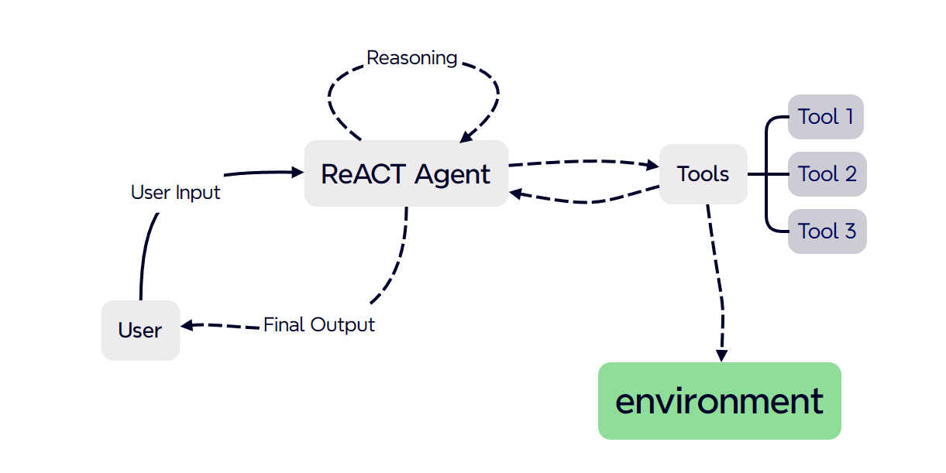
Repeat N times

Slide 4
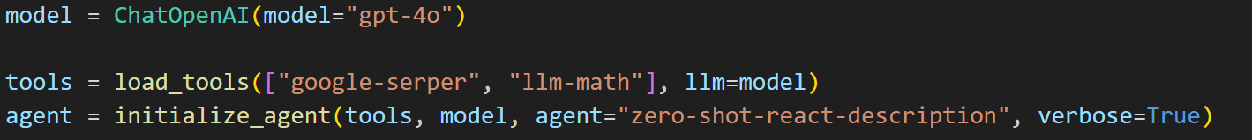
Agent Prompt:
Answer the following questions as best you can. You have access to the following tools:
google_serper - A low-cost Google Search API.Useful for when you need to answer questions about current events.Input should be a search query.
Calculator(*args: Any, callbacks: Union[list[langchain_core.callbacks.base.BaseCallbackHandler], langchain_core.callbacks.base.BaseCallbackManager, NoneType] = None, tags: Optional[List[str]] = None, metadata: Optional[Dict[str, Any]] = None, **kwargs: Any) -> Any - Useful for when you need to answer questions about math.
Use the following format:
Question: the input question you must answer
Thought: you should always think about what to do
Action: the action to take, should be one of [google_serper, Calculator]
Action Input: the input to the action
Observation: the result of the action
... (this Thought/Action/Action Input/Observation can repeat N times)
Thought: I now know the final answer
Final Answer: the final answer to the original input question
Begin!
Question: {input}
Thought:{agent_scratchpad}
Black part is the prompt template,
Red part is the toolset information,
Brown part is the question for agent

Slide 5
To answer your questions, I need to find the information about the new building at Georgetown University and calculate the age of the university raised to the 0.23 power. I will start by searching for information about the new building.
Action: google_serper
Action Input: "new building at Georgetown University 2023"
Observation: Redevelopment of the former Henle Village (May 2023 – August 2025) Event: Construction of a new residential hall featuring 780 beds, expanded health and wellness spaces, fully-equipped apartments with kitchens, increased space for CAPS, amenity areas, and an exterior courtyard.
Thought:The new building at Georgetown University is a residential hall being constructed as part of the redevelopment of the former Henle Village. Now, I need to find the age of Georgetown University.
Action: google_serper
Action Input: "Georgetown University founding year"
Observation: Georgetown University: Private university in Washington, D.C.. Georgetown University is a private Jesuit research university in the Georgetown neighborhood of Washington, D.C., United States. Founded by Bishop John Carroll in 1789, it is the oldest Catholic institution of higher education in the United States and the nation's first federally chartered university... [309 words]
Thought:Georgetown University was founded in 1789. Now, I need to calculate the age of the university raised to the 0.23 power. The current year is 2023, so the age of the university is 2023 - 1789.
Action: Calculator
Action Input: 2023 - 1789
Observation: Answer: 234
Thought:The age of Georgetown University is 234 years. Now, I need to calculate 234 raised to the 0.23 power.
Action: Calculator
Action Input: 234 ** 0.23
Observation: Answer: 3.506869841422834
Thought:I now know the final answers.
Final Answer: The new building at Georgetown University is a residential hall being constructed as part of the redevelopment of the former Henle Village. The age of Georgetown University raised to the 0.23 power is approximately 3.51.
Question:
What is the new building of Georgetown University? What is the name of the new building? And what is the age of the university raised to the 0.23 power?
Output:
The new building at Georgetown University is a residential hall being constructed as part of the redevelopment of the former Henle Village. The age of Georgetown University raised to the 0.23 power is approximately 3.51.

Slide 6

Our Idea

Slide 7
Managing finances can be a challenging task, especially when it's hard to track where your money goes.
Sometimes, even identifying items on receipts can be confusing—this is particularly true for me as a non-native English speaker.
I also wish there were a way to stop myself from buying duplicate items, like that frozen product buried deep in my freezer that I completely forgot about.
To address these issues, we aim to create a personal financial management app with the following features:
Expense Tracking: Easily record daily expenses.
Spending Summaries: Generate weekly and monthly summaries to review your financial habits.
Automatic Merging: Automatically consolidate expenses (e.g., group items purchased from the same merchant, such as Costco, in a single transaction).
Expense Analysis: Provide insights into spending patterns by category and merchant.
Receipt Recognition: Help identify items listed on receipts for easier tracking.
Text Parsing: Interpret unstructured text inputs like "bought a used PC for 300 dollars yesterday" into structured data (e.g., ("buy used PC", "300", "2024-10-15")).

Slide 8
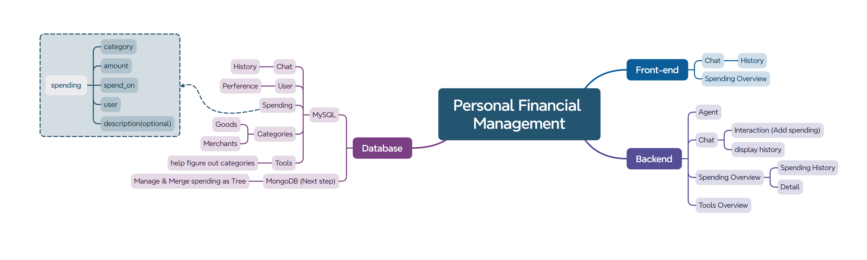
Project Structure

Slide 9




Project Structure
Backend
Frontend
UI

Slide 10
Tools - Overview
Langchain Tools:
Google-serper
llm-math
Personalized Tools:
process_receipt
create_or_update_expense_tool
category_merchant_tool
parse_relative_time
get_related_time

Slide 11
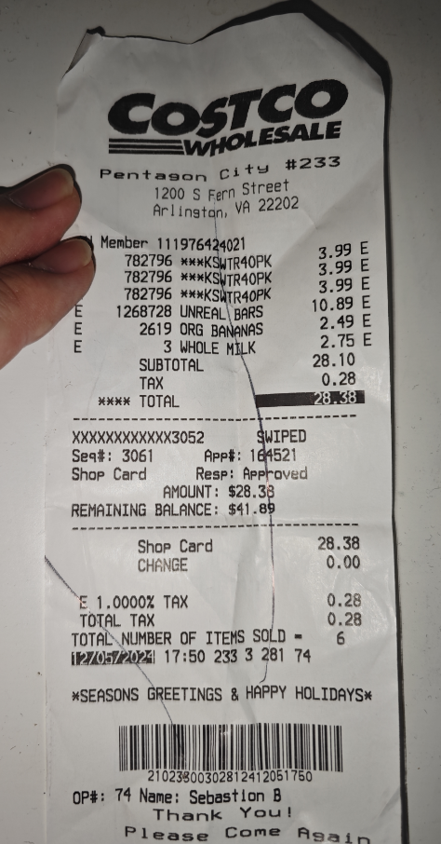
Tools - process_receipt
User input
{
"merchant": "Costco Wholesale",
"time": "12/05/2024 17:50",
"good_list": [
{ "name": "***KSWTR40PK", "price": 3.99 },
{ "name": "***KSWTR40PK", "price": 3.99 },
{ "name": "UNREAL BARS", "price": 10.89 },
{ "name": "ORG BANANAS", "price": 2.49 },
{ "name": "3 WHOLE MILK", "price": 2.75 }
]
}
Reasoning
Process Receipt

Slide 12
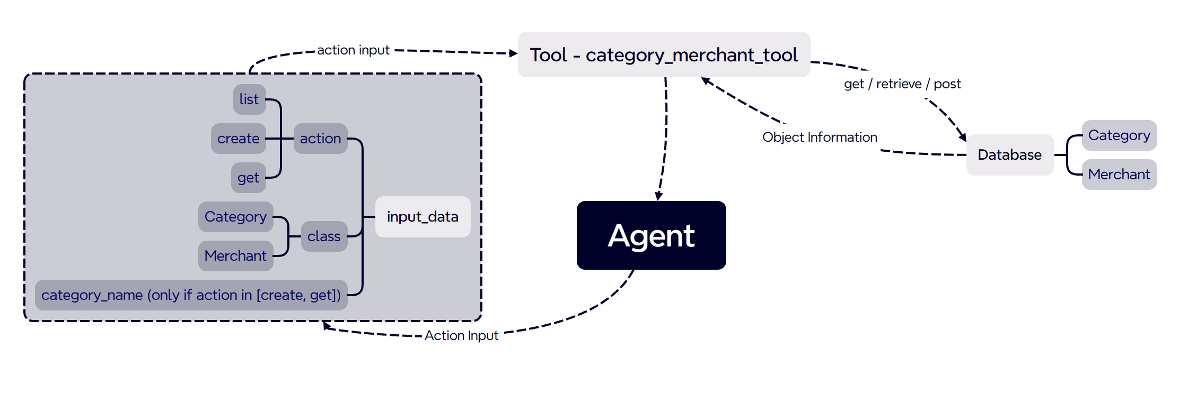
Tools - category_merchant_tool

Slide 13
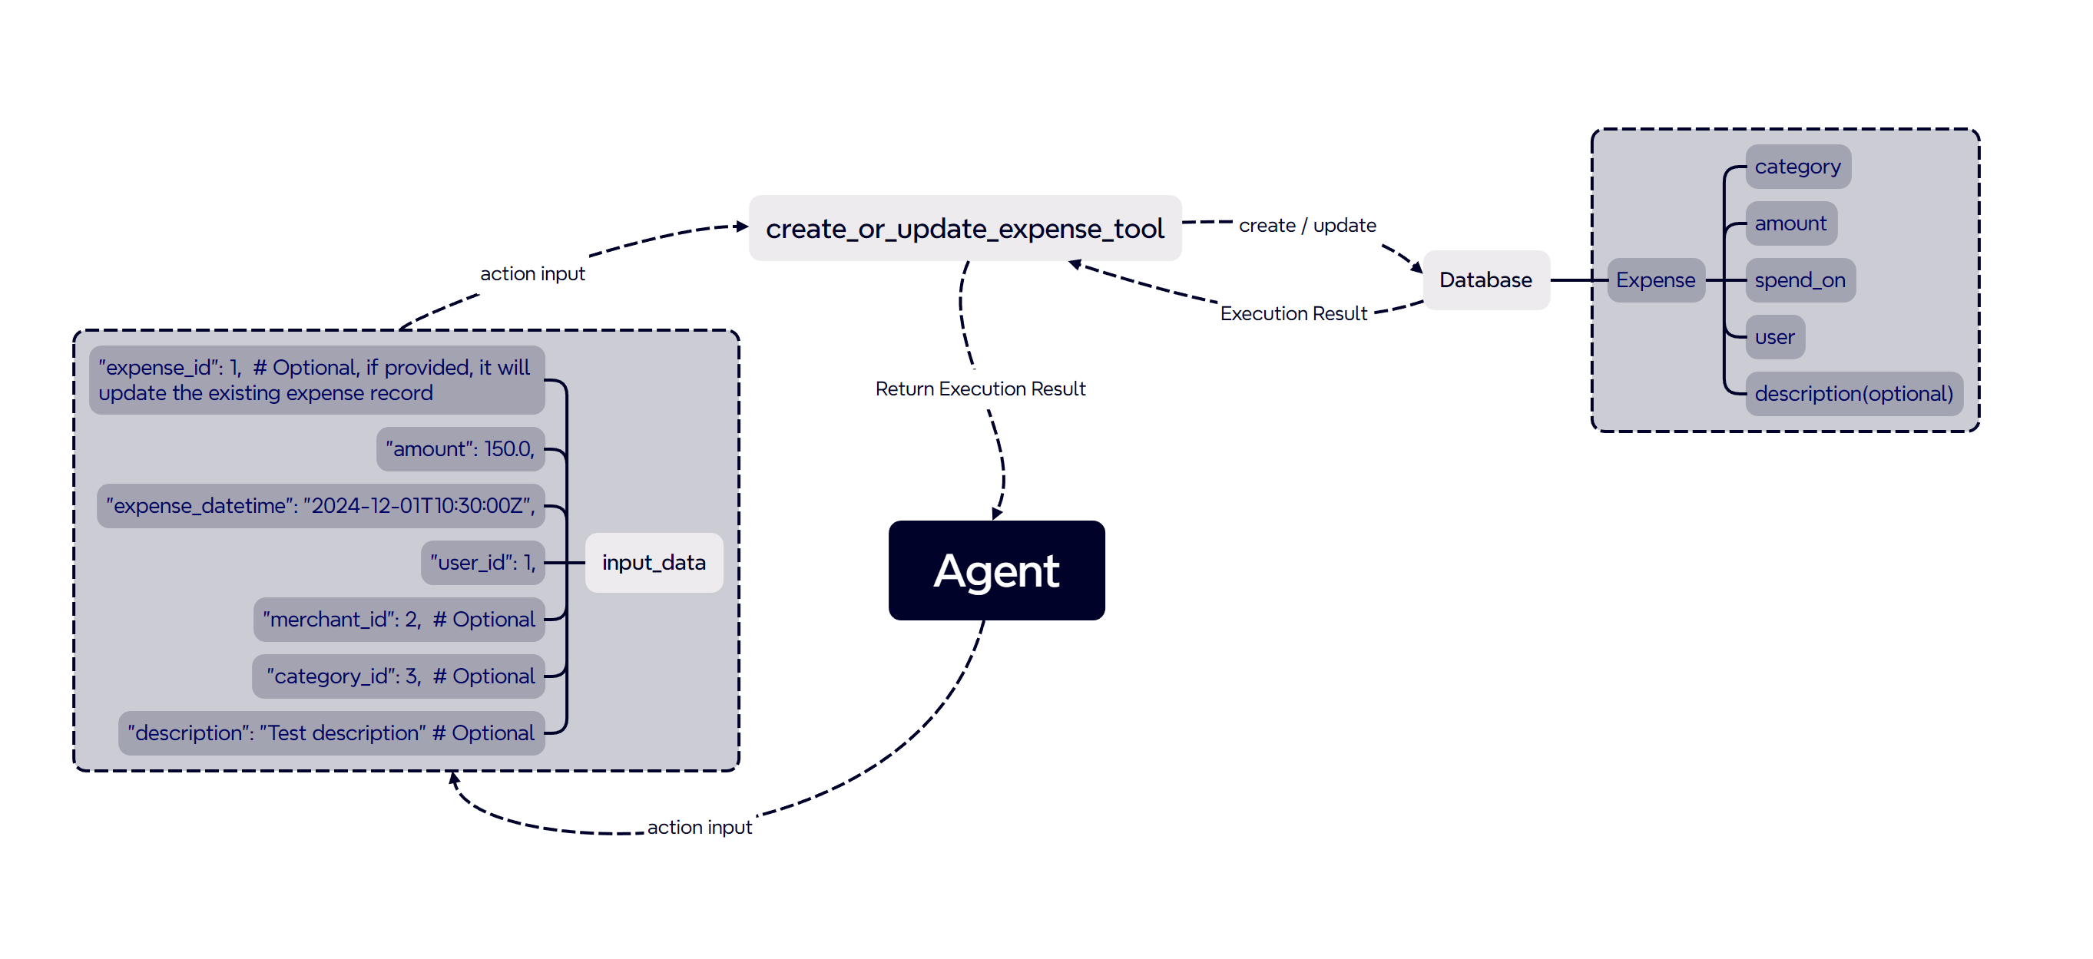
Tools - create_or_update_expense_tool

Slide 14
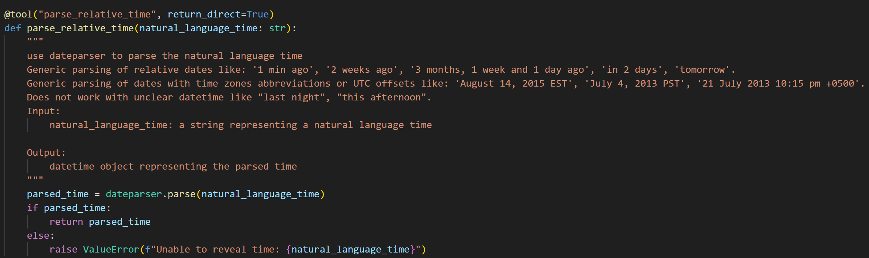
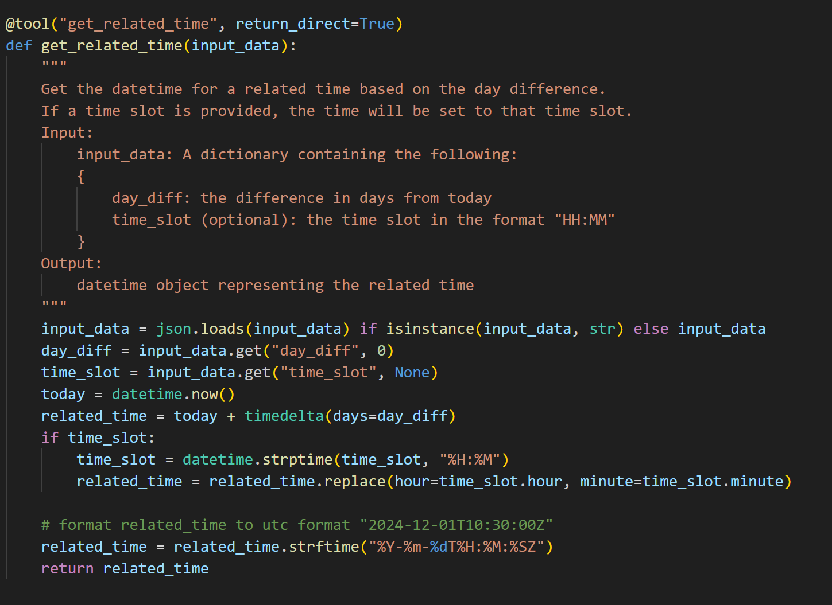
Tools - get_related_time

Slide 15
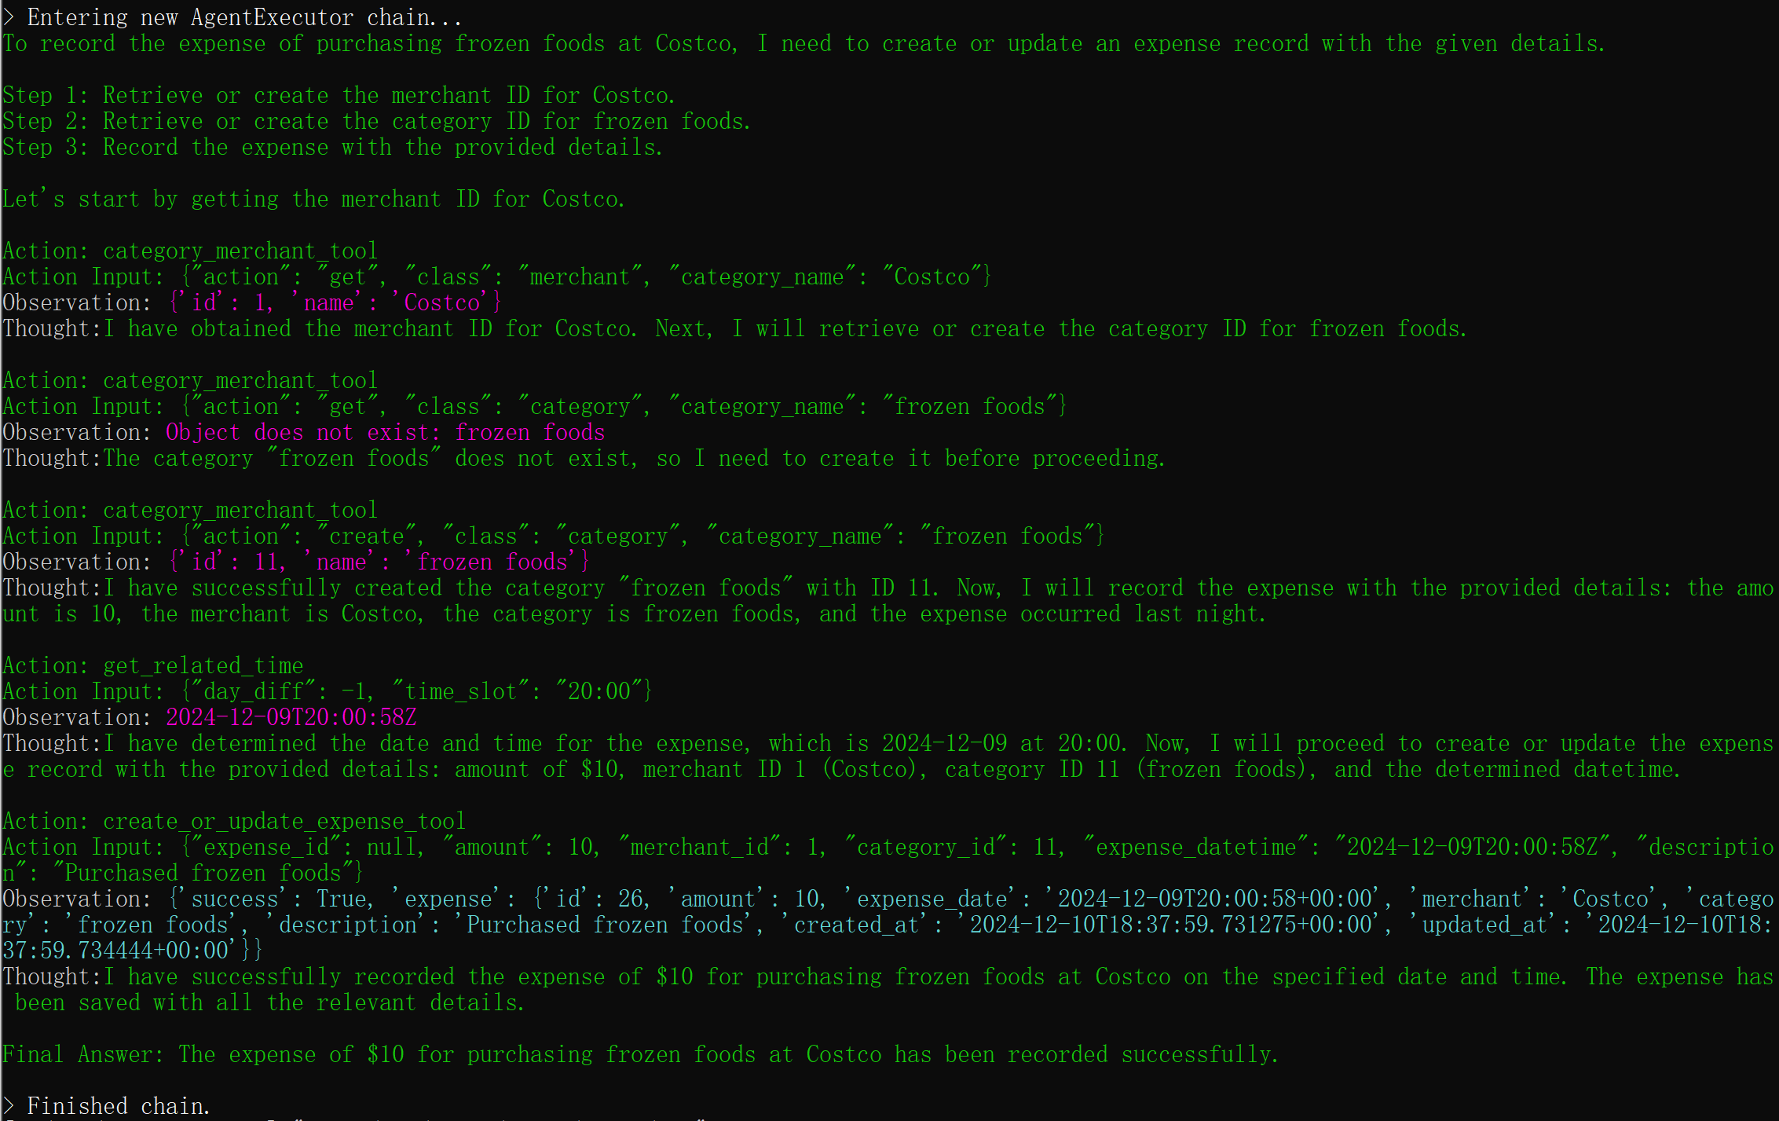
I've spent 10 purchasing frozen foods in costco last night, please help me record it

Slide 16
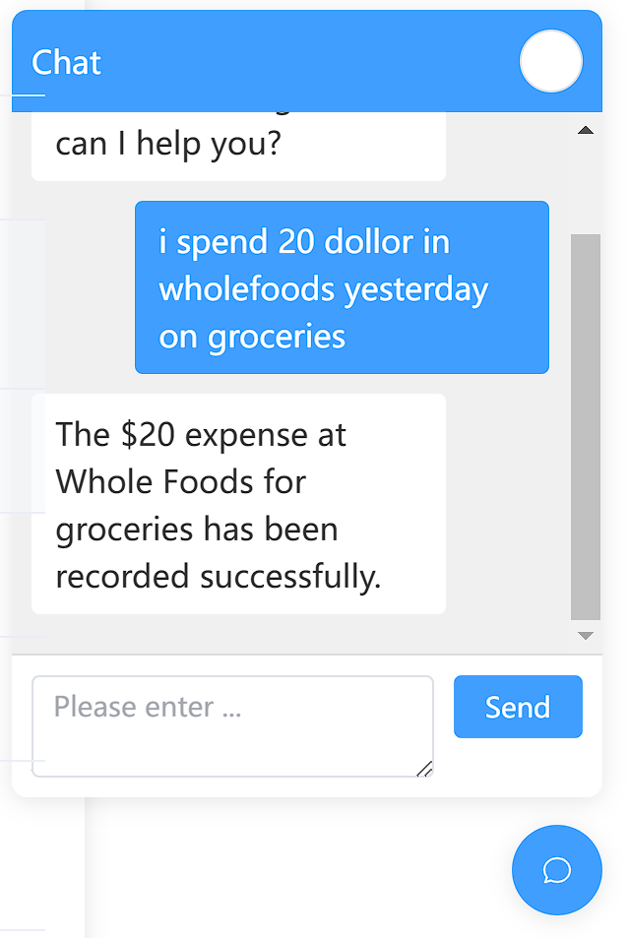
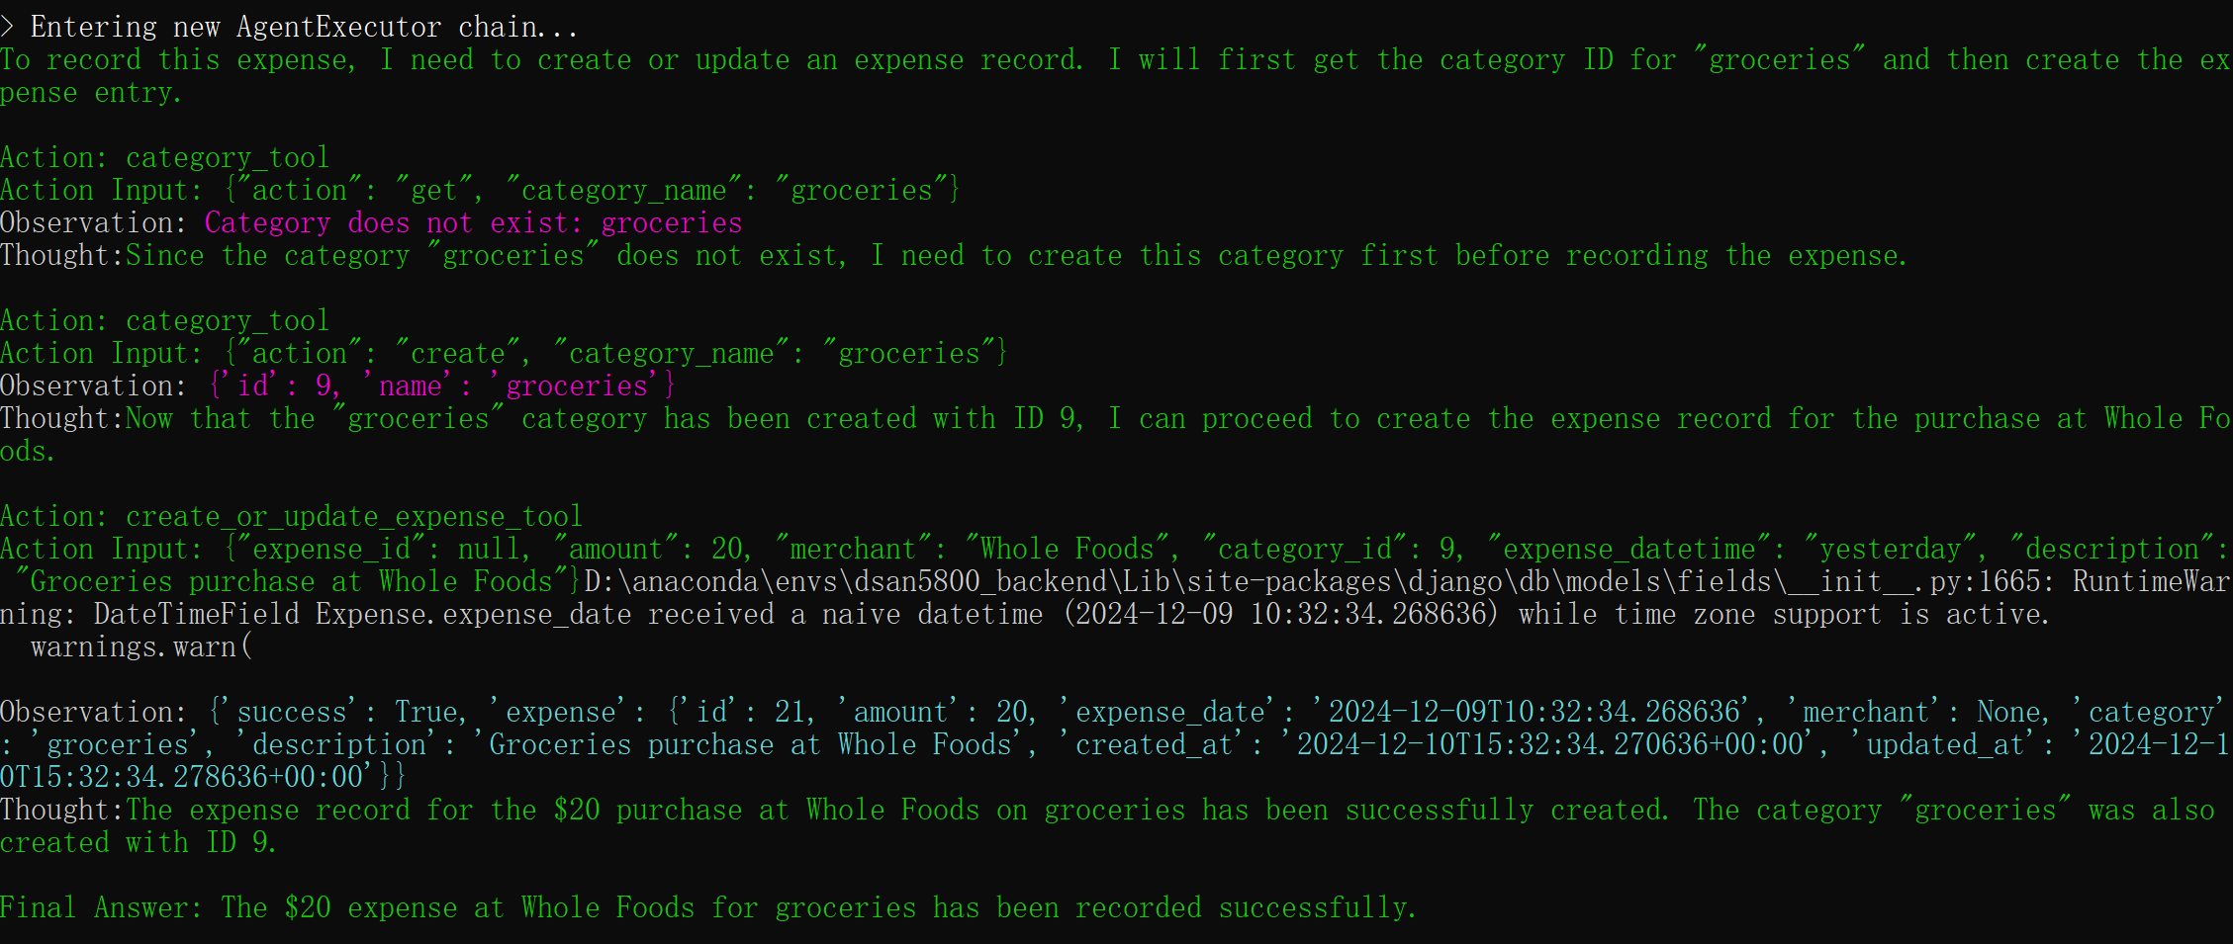

Slide 17
Conclusion
Most of the functions can be achieved by hard coding, but we want to use LLM to replace it, and add functions providing more tools to the model.
What we are designing is letting a model understand what the user wants to do and what tools it has, and then performing the corresponding operations by ReACT.

